Slide 1
Instacart Market Basket Analysis
Which products will an Instacart consumer purchase again?

Slide 2
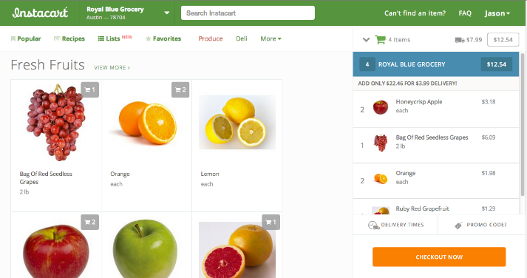
Business Statement
Instacart is a grocery ordering and delivery app.
Once the consumer selects products through the Instacart app, stores review customer’s order and do the delivery for them.
Instacart has open sourced it’s 3 million customer orders.
We have created an algorithm to predict which purchased product will be re-ordered.

Slide 3
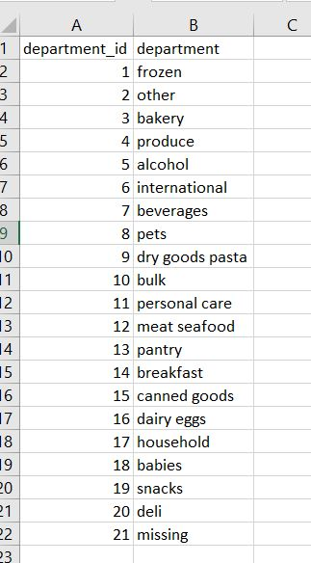
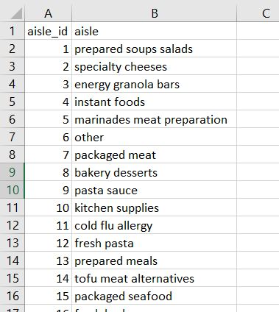
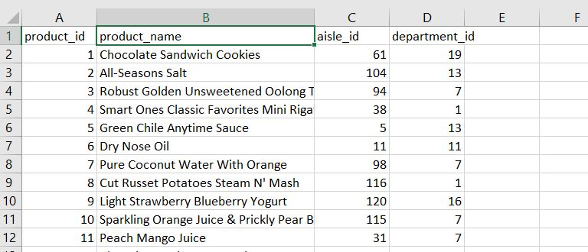
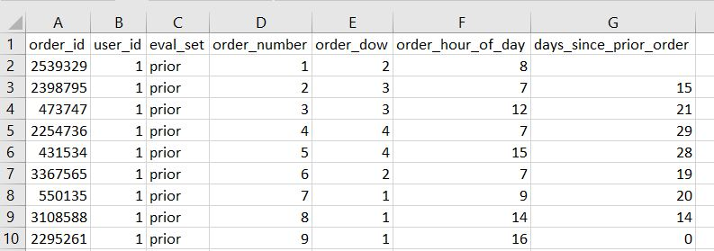
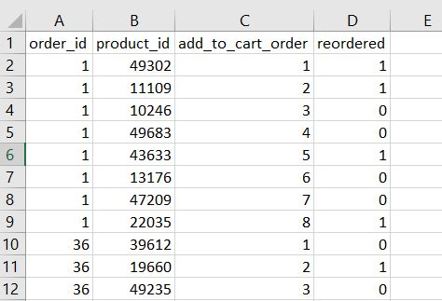
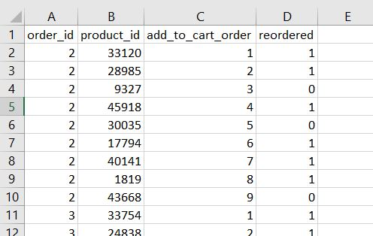
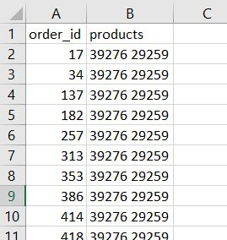
Understanding the Files
We have 7 different files:
Departments
Aisles
Products
Orders
Prior Orders
Train Orders
Test Orders

Slide 4
Data- All at Once
Department
Prior
Product
Orders
Aisles
Train

Slide 5
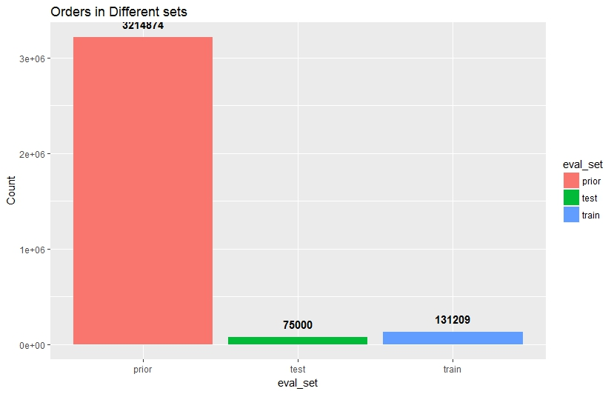
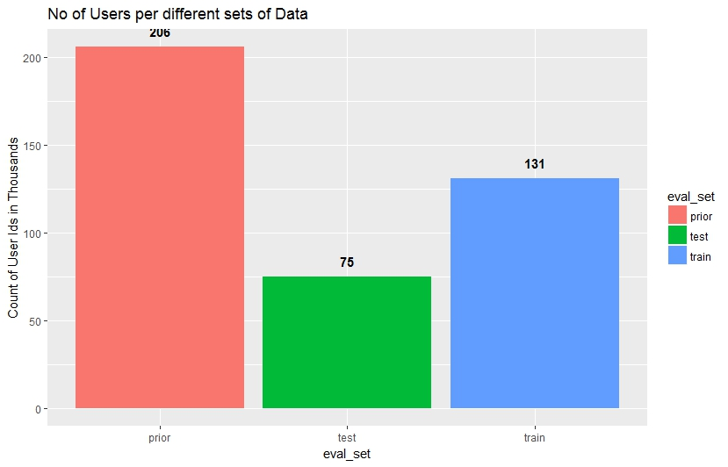
Orders Dashboard

Slide 6
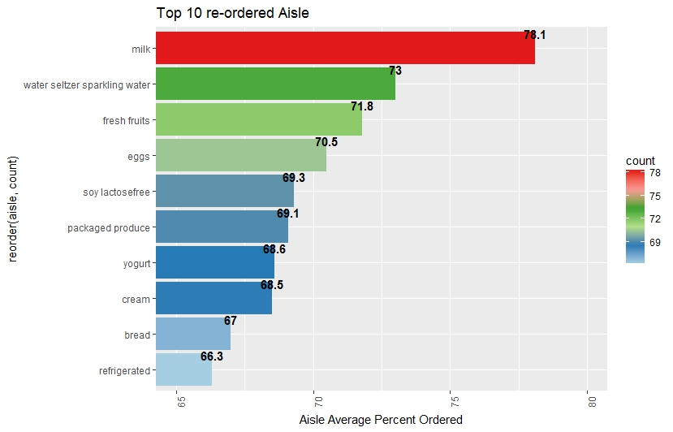
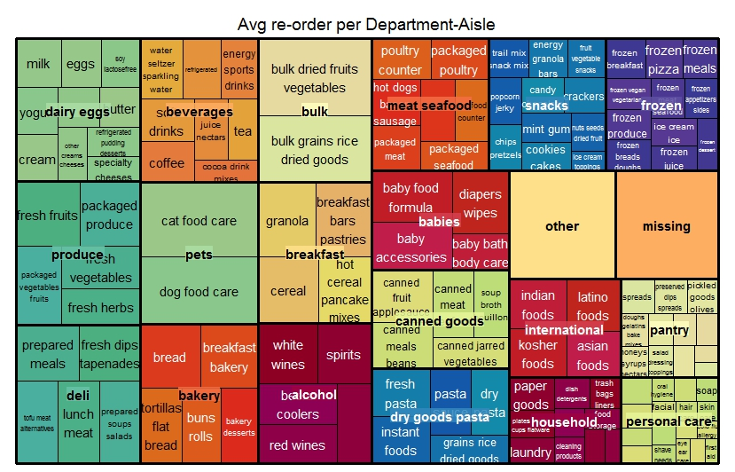
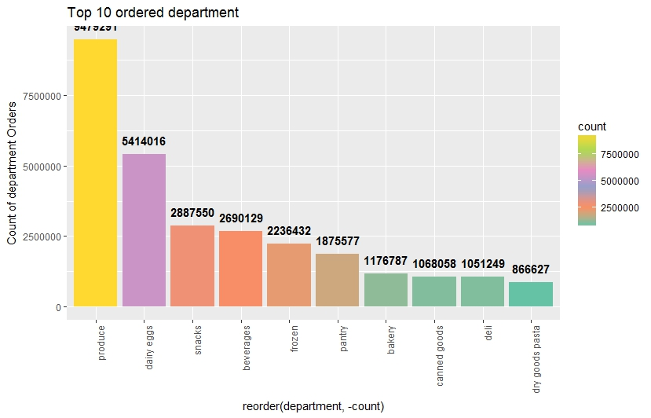
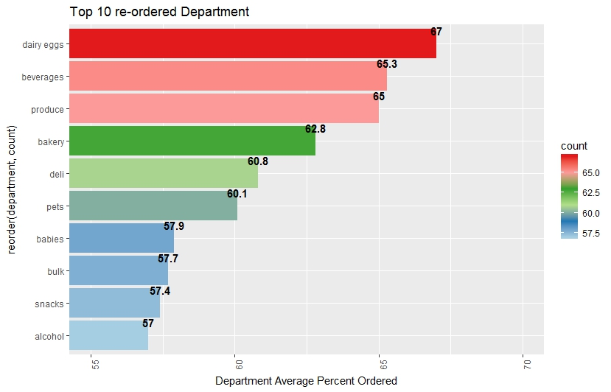
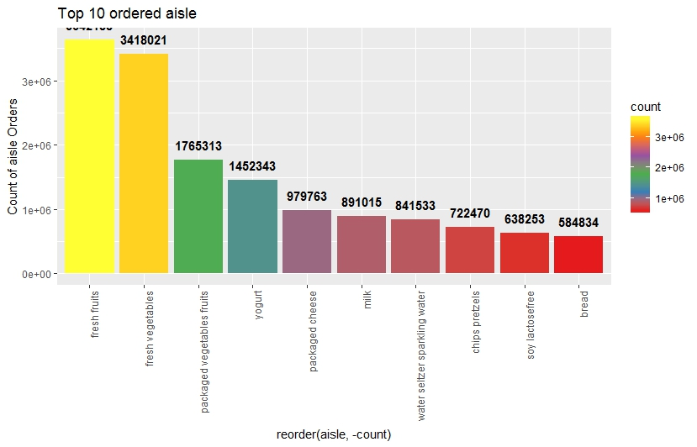



Department-Aisle Dashboard

Slide 7
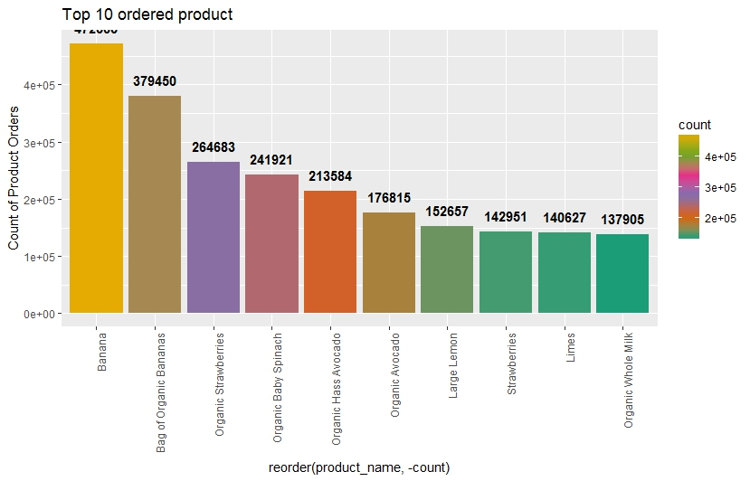
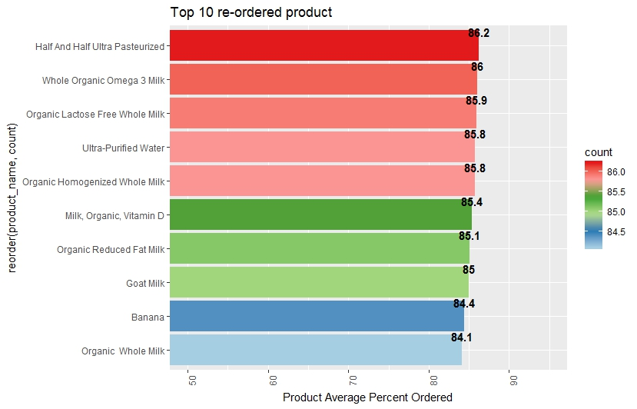
Product Dashboard

Slide 8
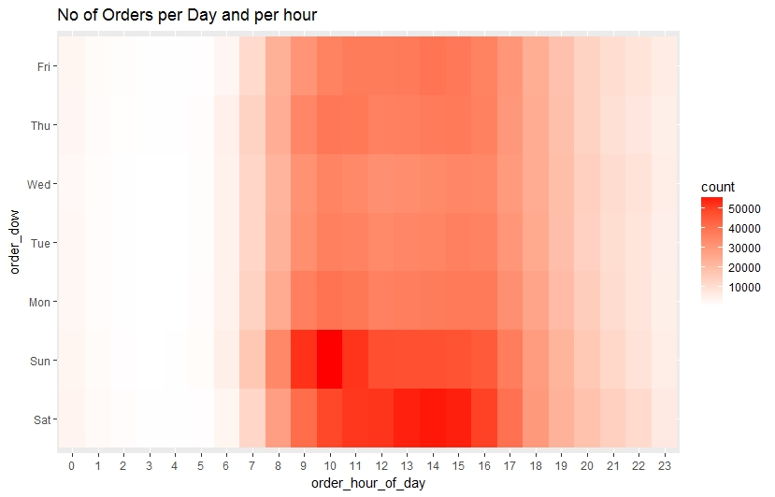
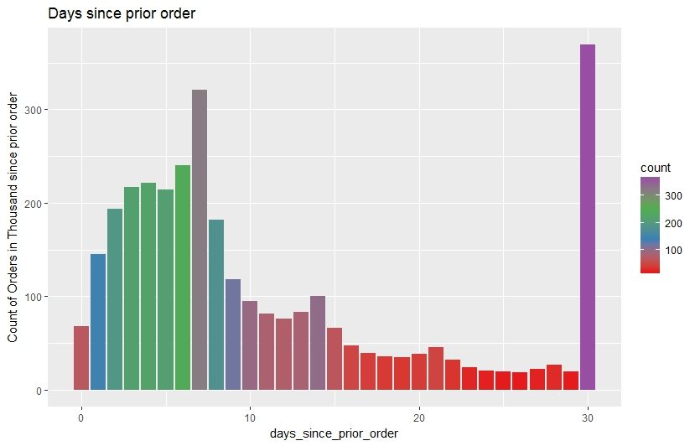
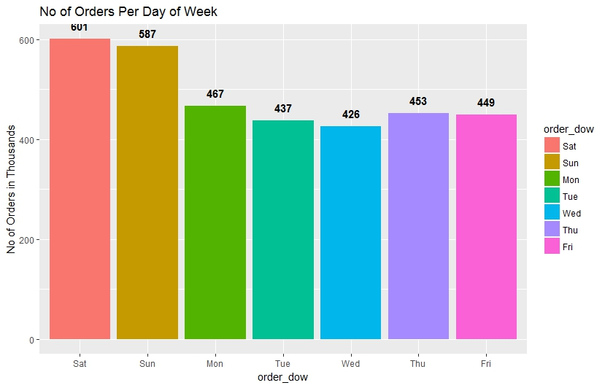
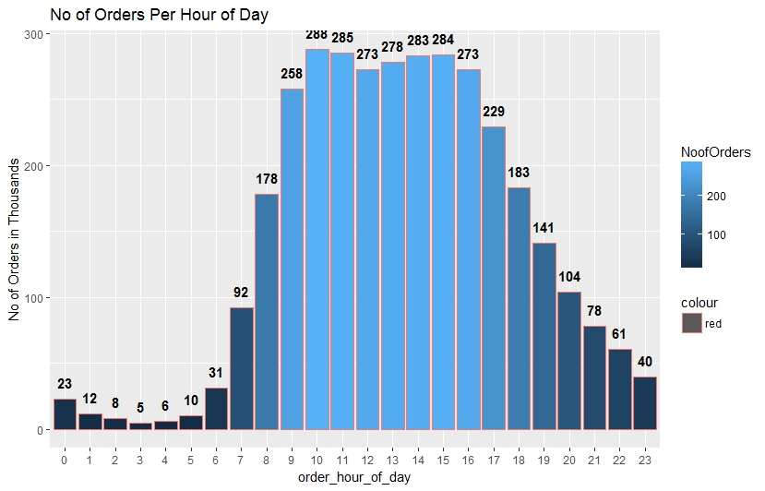
Order-Day-Hour Dashboard

Slide 9
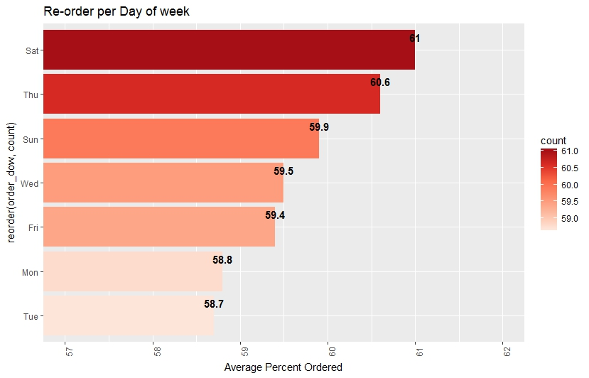
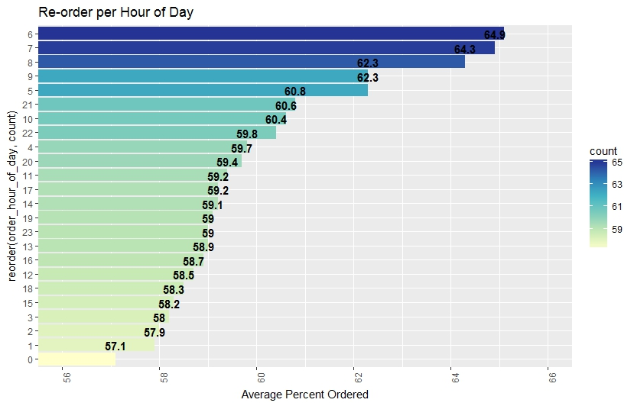
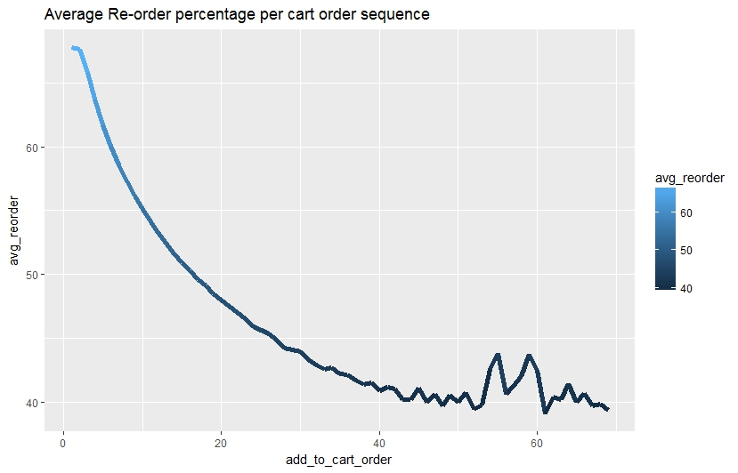
Re-order Day-Hour Dashboard

Slide 10
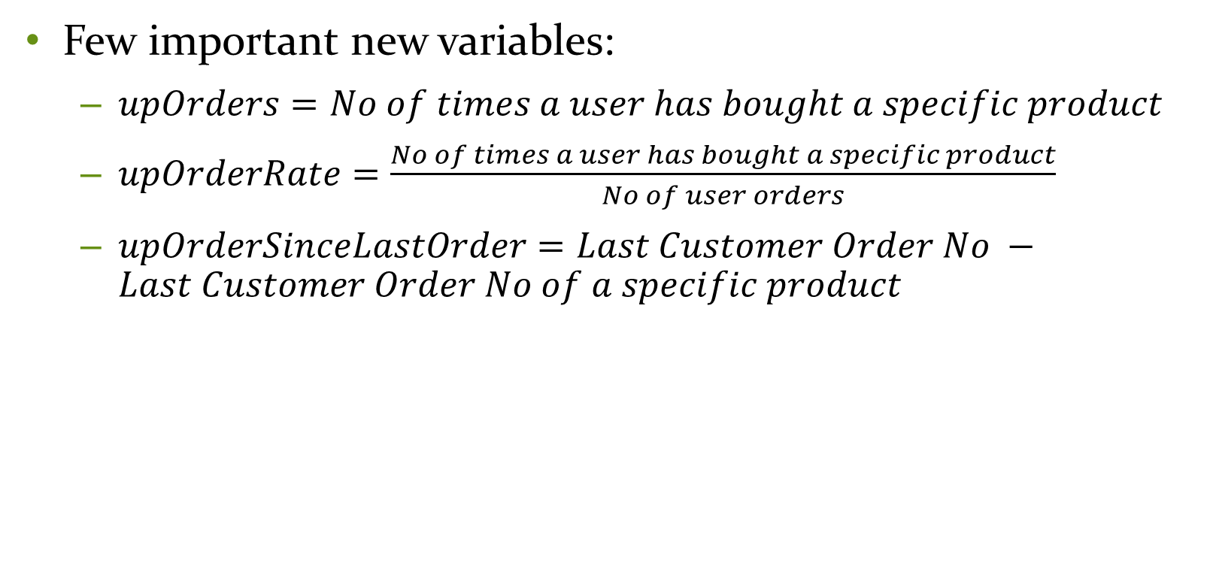
New Variables
Few important new variables:
$upOrders=No of times a user has bought a specific product$
$upOrderRate=\frac{No of times a user has bought a specific product}{No of user orders}$
$upOrderSinceLastOrder=Last Customer Order No −Last Customer Order No of a specific product$

Slide 11
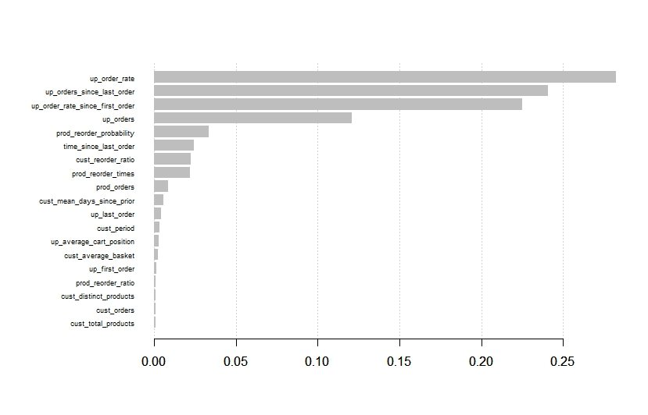
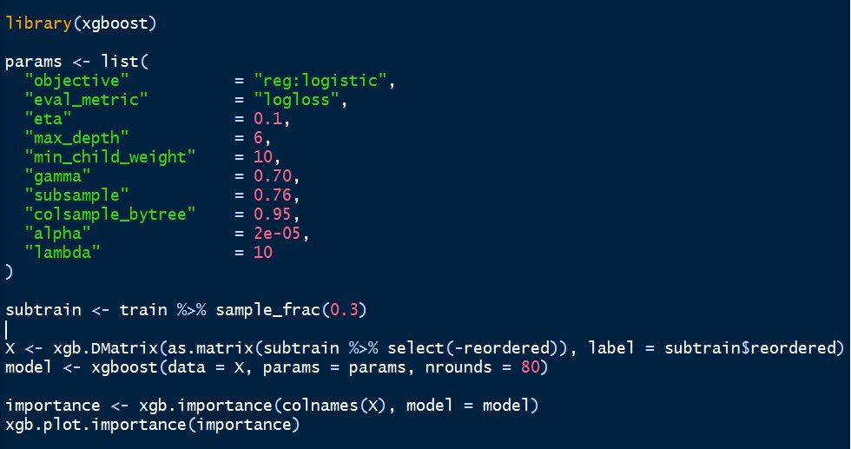
Model

Slide 12
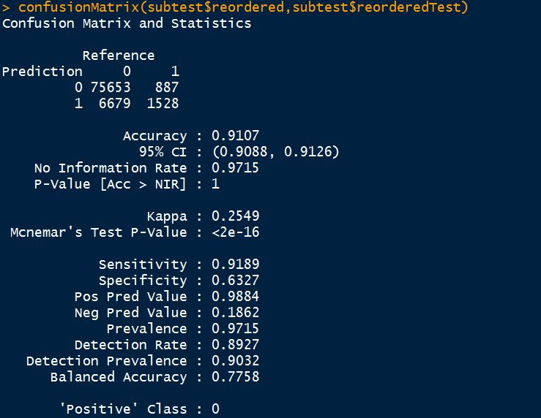
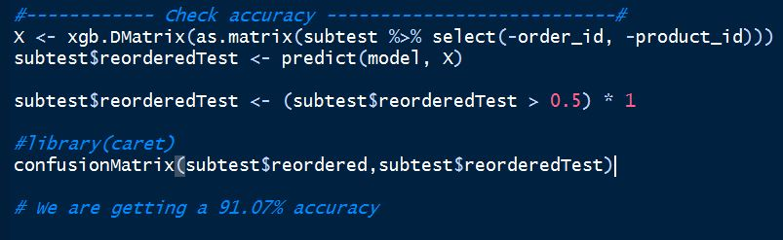
Model Evaluation

Slide 13
Recommendation
Instacart should develop a recommendation system based on the algorithm.
User should be suggested with the products that they are most likely to buy next.

Slide 14
Questions?
Thank you.

